Slide 1

ZOMATO SALES ANALYSIS
Submitted By – Akshay Sopori

Slide 2

History of Zomato
Founding (2008):
Zomato was founded in 2008 by Deepinder Goyal and Pankaj Chaddah as "Foodiebay."
It started as an online platform for restaurant discovery and reviews in Delhi NCR, India.
Expansion (2010-2012):
In 2010, the company expanded its services to other cities in India.
By 2012, it had extended its operations internationally to countries like UAE, UK, South Africa, and New Zealand.
Rebranding (2010):
In November 2010, the company rebranded itself from "Foodiebay" to "Zomato" to avoid confusion with the eBay brand.
Diversification (2015-present):
Zomato diversified its services beyond restaurant discovery to include food delivery and table reservations.
It acquired various companies to strengthen its position in the food delivery market, both in India and internationally.

Slide 3
History of Zomato
International Presence (2016-present):
Zomato continued its international expansion, entering markets across Asia, Europe, and the Middle East.
It faced stiff competition from local and international players in these markets.
Technology and Innovation (2017-present):
Zomato invested heavily in technology and innovation, introducing features like AI-driven recommendations, real-time tracking of food orders, and contactless dining options.
IPO (2021):
In July 2021, Zomato went public with its initial public offering (IPO), raising over $1.3 billion.
The IPO was one of the largest in India's history and marked a significant milestone for the company.
Expansion into Adjacent Services (2022-present):
Post-IPO, Zomato expanded into adjacent services like grocery delivery, online pharmacy, and hyperlocal delivery of other goods.

Slide 4
Problem Statements
Suggest few Countries where Zomato can open new Restaurants.
Suggest few cities in suggested countries.
Analyze the quality regarding ratings for restaurants that are already present in the countries.
Analyze the expenditure on food.
Analyze the competitors and restaurants which are not competition.
Analyze the cuisines that need to be focused.
Analyze the trends of the Online deliveries and table bookings.

Slide 5
Overview of Data
Raw Data has in total 20 attributes. ( Columns )
Cleaned Data having 30 attributes.
Description: Contains restaurant information like name, location, cuisine, pricing, and ratings, date of opening etc.
Country Description has the country code and the country name
Description: Provides country details such as code, name.
Have created one more table which will have the currency conversion rate in US dollars to have a generic price for all restaurants.
Data Cleaning :
Corrected date of opening column in proper date format.
Handling missing or inconsistent values.
Incorporating country information using lookup functions.
Updating average cost for two and cuisines based on specific criteria.

Slide 6
Countries to open new restaurants
Points considered for suggesting new restaurants:
Less number of restaurants = Less competition
Lower ratings = High potential for growth for new restaurants
If the restaurants already operating in a particular area is less, then new restaurants can be opened as there will be less competition.
Secondly the ratings play a huge role while deciding places for new restaurants since ratings tells whether customers of a particular region are satisfied with the food & services offered or not.

Slide 7


Countries to open new restaurants
After analysing data wrt to the points mentioned, the below countries are best suited for opening of new restaurants.
Canada, Australia, Singapore and Sri Lanka
The average ratings in the suggested country ranges from 3.6 to 3.9.
The number of restaurants currently operating are also less between 4-24

Slide 8
Cities in suggested countries to open new restaurants
Cities with less number of restaurants and lower ratings are best suited for opening of new restaurants.
After analysis the cities where new restaurants should be opened are.
Canada – Consort & Chatham –Kent
Australia – Montville, Paynesville, Mayfield
Singapore – Singapore
Sri Lanka - Colombo

Slide 9

Ratings of restaurant already present in suggested countries.

Slide 10
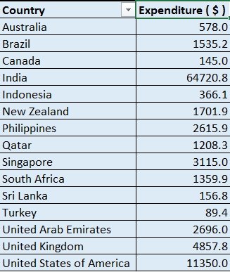
Expenditure of food
To better analyse the total expenditure of food in each country we have converted the price in USD for each country.

Slide 11



Competitors in each location
The restaurants with higher ratings in suggested countries and cities are the potential competitors.
Australia Canada
Singapore Sri lanka

Slide 12


Cuisines that needs to be focused
The cuisnes which have the highest ratings in suggested countries and cities are the cuisines which needs to be focused on.
Australia Canada
Singapore Sri lanka

Slide 13
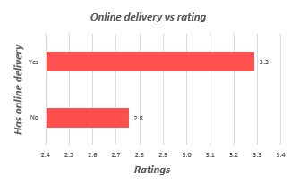
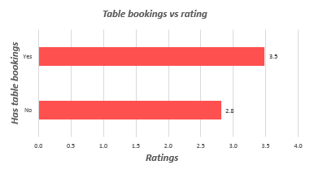
Trends of table bookings & online deliveries
As per the analysis we came to the conclusion that the restaurants which offer table bookings and online delivery are likely to have more better ratings.
So while opening new restaurants we can focus on the table bookings & online deliveries.

Slide 14
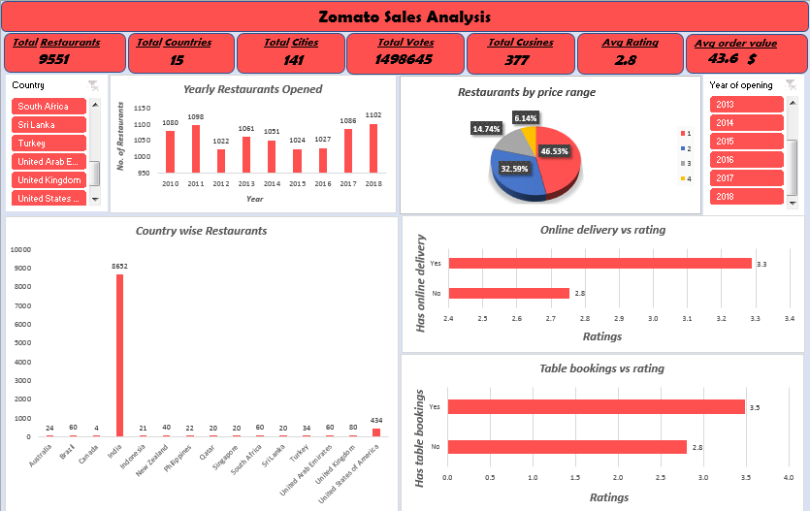
Dashboard & Visualisations

Slide 15
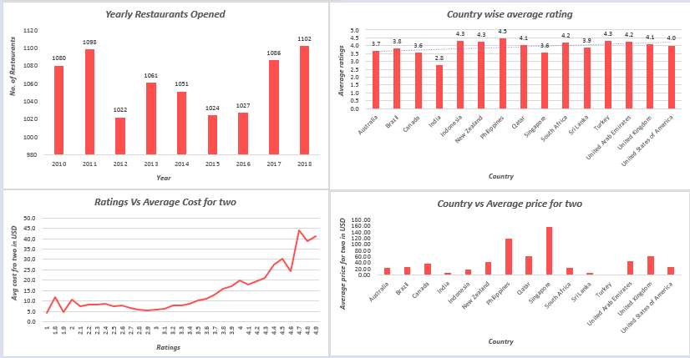
Dashboard & Visualisations

Slide 16
Methodology
Used Microsoft Excel for data analysis, cleaning, preprocessing, and visualization.
Leveraged Excel functions and tools such as Pivot Tables, Conditional Formatting, Lookup Functions, and Statistical Functions.
Steps included data cleaning, preprocessing, enrichment, and enhancement.
Analyzed data using pivot tables and conducted correlation analysis.
Visualized data with charts and graphs for creating dashboards.

Slide 17
Methodology
Enhancement :
Enriched modified data with country information using lookup functions.
Filled up the missing values with the help of mean and mode.
Fixed the data discrepancies with the help of excel functions.
Added few helper columns in the cleaned data set for better analysis.

Slide 18
Insights
New Restaurant Locations:
Recommendation: Open restaurants in Australia, Canada, Singapore, and Sri Lanka.
Justification: These countries has low competition and existing restaurants have low ratings which shows there is a better opportunity for growth.
Cuisine Selection:
Recommendation: Offer a diverse range of cuisines including Pizza, Mediterranean, Australian, Italian, Chinese, Bakery, Seafood, American, Continental, Desserts, and Beverages.
Justification: Different countries have different cuisines to offer, and in the countries suggested the above cuisines have the highest ratings which means these are the most desired cuisines which shows more customers are likely to order those cuisines.
Online Delivery and Table Booking:
Recommendation: Implement online delivery and table booking services.
Justification: As per the analysis it was clearly visible that the restaurants which provide table bookings and online delivery have higher ratings.

Slide 19
Conclusions
The analysis reveals valuable insights for restaurant data, guiding strategic decisions for expansion and improvement. Key findings include:
Identification of countries with low competition and high potential of growth for new restaurant ventures.
Understanding customer preferences and the impact of factors like offers online delivery, has table bookings, type of cuisines offered, price range, and services on ratings.
Recommendations for targeted culinary offerings, service enhancements, and pricing strategies to enhance customer satisfaction and competitiveness.
Visualizations provide clear insights into market trends, competitor analysis, and financial expenditure.
This analysis underscores the importance of data-driven decision-making in the restaurant industry, enabling businesses to optimize performance and meet evolving consumer demands effectively.

Slide 20
THANK YOU

